Slide 1


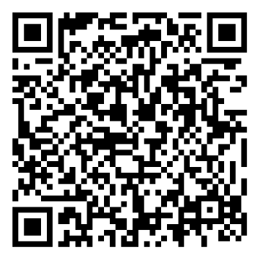
the
Herbert Protocol
Do you have a loved one with Dementia or Alzheimer’s
Are they at risk of going missing?
The Herbert Protocol is an information gathering tool to assist the police to find a person, living with dementia who has been reported missing, as quickly as possible.
Download the Herbert form by scanning the QR code
Or visit your local GP practice

